Slide 1
Model Evaluation
Results & best models
About SOC differences

Slide 2
Results & best models
Format: MSE & SOC MAE & SOC
Datasets Models | Servo | Auto MPG | Forest Fire
MLP | 0.0009 & 1508 0.0239 & 1508 | 6.6186 & 102 1.9511 & 102 | 15.1198 & 104 2.2864 & 104
MT | 0.1266 & 19 0.2083 & 19 | 6.7172 & 21 1.8403 & 21 | 18.1344 & 31 3.1534 & 31
SVR | 0.1302 & 1261 0.2277 & 1183 | 6.8441 & 8360 1.9320 & 8382 | 14.7308 & 10425 2.1996 & 10150

Slide 3
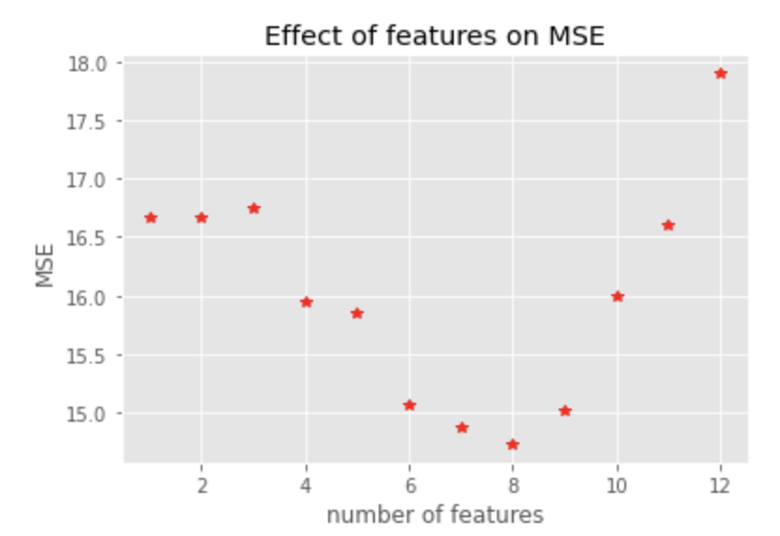
About SOC differences (conceptual)
SVR finds/chooses support vectors while training and finds dual coefficients. To make decision, model considers all support vectors and dual coefficients and makes kernel transformation.
Forest Fire with SVR

Slide 4
MLP Cross Validation
params_1 = {
'activation': ['logistic', 'tanh', 'relu'],
'hidden_layer_sizes': [(1,), (10,), (100,), (200,)],
'learning_rate_init': np.logspace(-4,-2, 20)
}
params_2 = {
'activation': ['logistic', 'tanh', 'relu'],
'hidden_layer_sizes': [(1, 1), (10, 10), (100, 100)],
'learning_rate_init': np.logspace(-4,-2, 20)
}
params_3 = {
'activation': ['logistic', 'tanh', 'relu'],
'hidden_layer_sizes': [(1, 1, 1), (10, 10, 10), (100, 100, 100)],
'learning_rate_init': np.logspace(-4,-2, 20)
}
Best Hyperparameters::
{'activation': 'relu', 'hidden_layer_sizes': (100,), 'learning_rate_init': 0.004832930238571752}
MSE/MAE = ?
Best Hyperparameters::
{'activation': 'relu', 'hidden_layer_sizes': (100, 100), 'learning_rate_init': 0.00615848211066026}
MSE/MAE = ?
Best Hyperparameters::
{'activation': 'relu', 'hidden_layer_sizes': (100, 100, 100), 'learning_rate_init': 0.007847599703514606}
MSE/MAE = ?

Slide 5
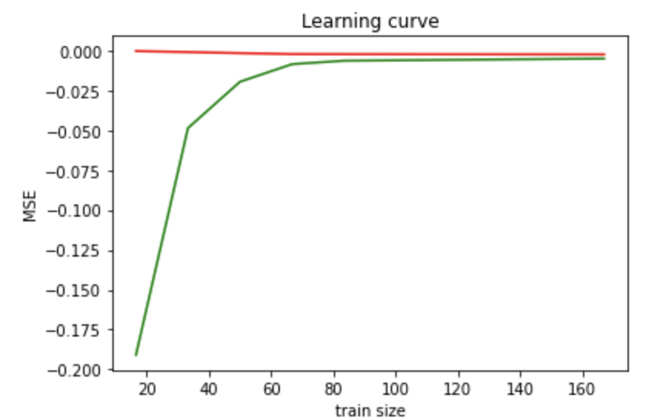
MLP Cross Validation
params_4 = {
'activation': ['relu'],
'hidden_layer_sizes': [(100,), (300,), (500,)],
'learning_rate_init': np.logspace(-4,-2, 20)
}
params_x = {
'activation': ['logistic', 'tanh', 'relu'],
'hidden_layer_sizes': [(100), (100, 100), (100, 100, 100), (100, 100, 100, 100, 100, 100, 100)],
'learning_rate_init': np.logspace(-4,-2, 20)
}
params_x = {
'activation': ['logistic', 'tanh', 'relu'],
'hidden_layer_sizes': [ (5,5, 5) (10, 10, 10)(20, 100, 100)(50, 50, 100) (100, 100, 100],
'learning_rate_init': np.logspace(-4,-2, 20)
}

Slide 6
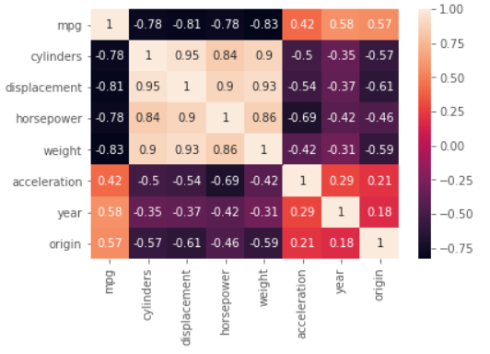
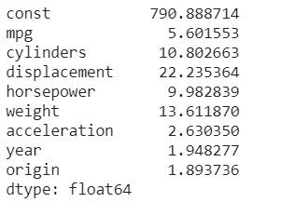
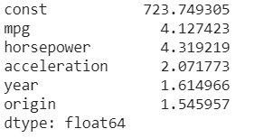
Variance_inflation_factor() to measure collinearity
Cylinders: displacement, horsepower, weight
Displacement
weight

Slide 7
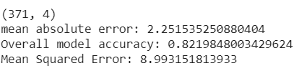

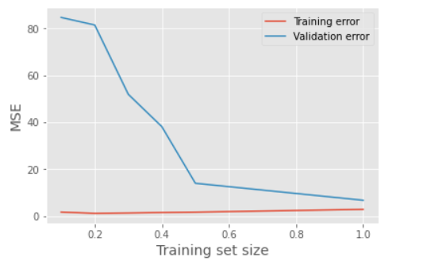
Comparing results after dropping 3 features
Training data fitted very well. Low gap between training error and validation error shows that model has low variance so, don't need to increase train size. Overall, it shows low bias and low variance.

